Slide 1


AUTOMATED REQUIREMENT ELICITATION VIA CHATBOT
PRESENTED BY:
HARIGOWTHAM. A
192324198
CSA1018
SOFTWARE ENGINEERING FOR APPLICATION DEVELOPMENT
Date: DD/MM/YYYY

Slide 2
Introduction:
Overview of the Project
AI-driven chatbot automates requirement elicitation using NLP and machine learning.
Engages stakeholders, asks relevant questions, and extracts structured requirements.
Integrates with Jira, Confluence, and Trello for seamless project management.
Ensures context-aware questioning to refine requirement accuracy.
Enhances scalability by adapting to different project domains and industries.
Problem Statement
Traditional requirement gathering is time-consuming and error-prone.
Misinterpretation and incomplete specifications lead to project inefficiencies.
Need for an automated system to refine, validate, and structure requirements.
Lack of standardization in requirement documentation affects project consistency.
Difficulty in tracking requirement changes leads to scope creep and project delays.
Purpose of the Project
Improve efficiency in requirement gathering using AI-driven automation.
Reduce miscommunication and enhance documentation accuracy.
Streamline integration with project management tools for better workflow.
Enable faster decision-making with real-time requirement analysis.
Enhance collaboration between stakeholders, reducing iteration cycles.

Slide 3
Objectives:
Define Clear Goals
Develop an AI-driven chatbot for automated requirement elicitation.
Ensure context-aware questioning for refining stakeholder inputs.
Enable seamless integration with Jira, Confluence, and Trello.
Maintain accuracy and consistency in requirement documentation.
Provide customizable templates for different project types.
Address the Problem Statement
Automate requirement gathering to reduce manual effort and errors.
Improve requirement clarity and reduce misinterpretation risks.
Standardize requirement documentation for better project alignment.
Ensure real-time tracking of changes to prevent scope creep.
Enhance collaboration between technical and non-technical stakeholders.
Expected Outcomes
Faster and more accurate requirement elicitation process.
Improved documentation quality with structured requirements.
Reduced project risks due to clear and well-defined specifications.
Enhanced efficiency in software development lifecycle (SDLC).
Scalable solution adaptable to various industries and project needs.

Slide 4
Literature Review / Background:
Summary of Existing Research
AI-driven chatbots have been explored for automating customer support and data collection.
NLP techniques like TF-IDF, Named Entity Recognition (NER), and intent detection improve chatbot interactions.
Requirement engineering studies highlight common challenges in manual elicitation, such as ambiguity and misinterpretation.
Existing AI solutions lack domain-specific adaptation for requirement gathering.
Theoretical Foundation
Based on Natural Language Processing (NLP) and Machine Learning (ML) for intelligent conversation.
Follows requirement engineering principles to structure elicitation methods.
Utilizes context-aware AI models for refining stakeholder inputs.
Applies knowledge representation techniques to organize and validate gathered requirements.
Research Gap
Limited research on AI-driven requirement elicitation chatbots tailored for software engineering.
Existing chatbots focus on generic conversations rather than structured requirement gathering.
Lack of real-time integration with project management tools like Jira and Confluence.
Need for a more interactive and adaptive chatbot that understands project-specific requirements.

Slide 5
Methodology:
Tools & Frameworks Used
Python for backend development.
NLTK & spaCy for Natural Language Processing (NLP).
Flask/Django for chatbot deployment.
TensorFlow/PyTorch for AI model training.
Development Approach
Agile methodology with iterative development cycles.
Prototyping-based approach for refining chatbot interactions.
Continuous testing & evaluation to improve chatbot accuracy.
User feedback integration to enhance requirement elicitation efficiency.
Data Collection (If Applicable)
Requirement documents & project reports for chatbot training.
Stakeholder interviews & surveys for real-world input.
Existing requirement datasets from software engineering repositories.
Feedback logs & chatbot interactions for continuous learning.

Slide 6

System Design / Architecture:
Flowcharts & block diagrams

Slide 7
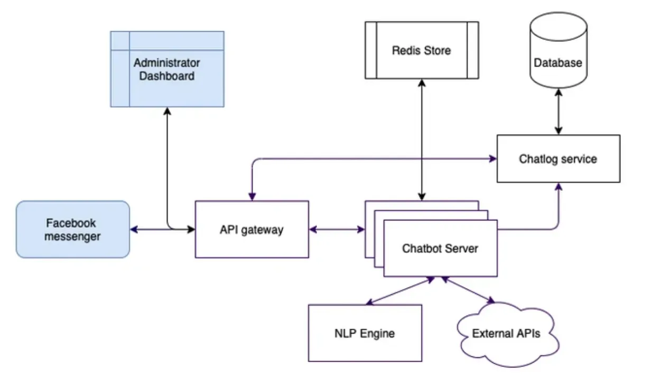
Technology Stack Used
Frontend: HTML, CSS, JavaScript (for chatbot UI).
Backend: Python (Flask/Django for API development).
AI/NLP: TensorFlow, PyTorch, NLTK, spaCy for natural language understanding.
Database: PostgreSQL/MySQL for storing elicited requirements.
Deployment: Docker & cloud services (AWS/Azure) for scalability.
System architecture

Slide 8
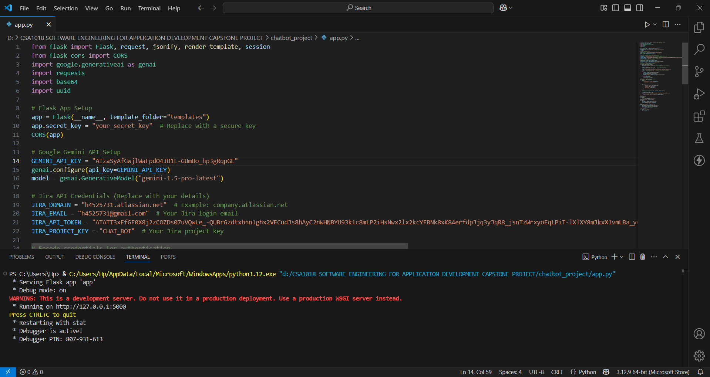
Implementation
Key features & functionalities
AI-powered chatbot for interactive requirement gathering.
Context-aware questioning for refining stakeholder inputs.
Export functionality for Jira, Confluence, and Trello.
NLP-based text processing for analyzing user responses.

Slide 9
Results & Discussion
Outcomes of the project
Improved efficiency in gathering software requirements.
Reduced misinterpretation and missing details in requirements.
Automated requirement documentation for seamless integration with project management tools.
Enhanced stakeholder engagement through interactive AI-driven questioning.
Comparison with existing solutions
Feature | Traditional Requirement Elicitation | AI-Driven Requirement Elicitation Chatbot
Efficiency | Time-consuming, manual process | Automated, reduces effort & time
Accuracy | Prone to misinterpretation | Context-aware questioning improves accuracy
Adaptability | Static forms, rigid questioning | Dynamically adjusts based on user input
Scalability | Limited to human capacity | Can handle multiple stakeholders simultaneously
Integration | Requires manual documentation entry | Exports structured data to Jira, Trello, etc.
Stakeholder Engagement | One-way communication (interviews, surveys) | Interactive, AI-driven conversation
Cost & Resource Efficiency | High human resource dependency | Reduces need for dedicated analysts
Error Handling | Limited validation of inconsistencies | Detects contradictions and refines queries

Slide 10
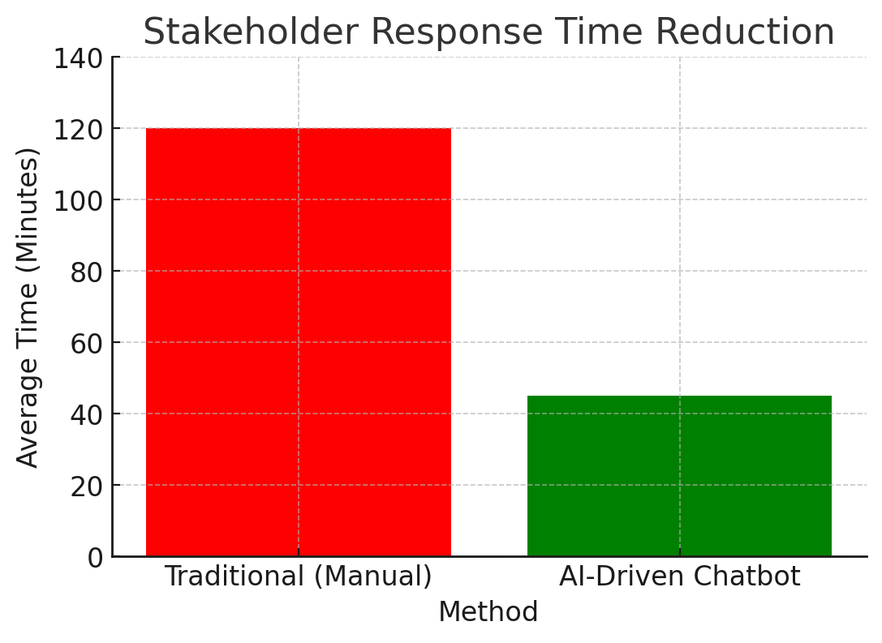
Data visualization (charts, tables)

Slide 11
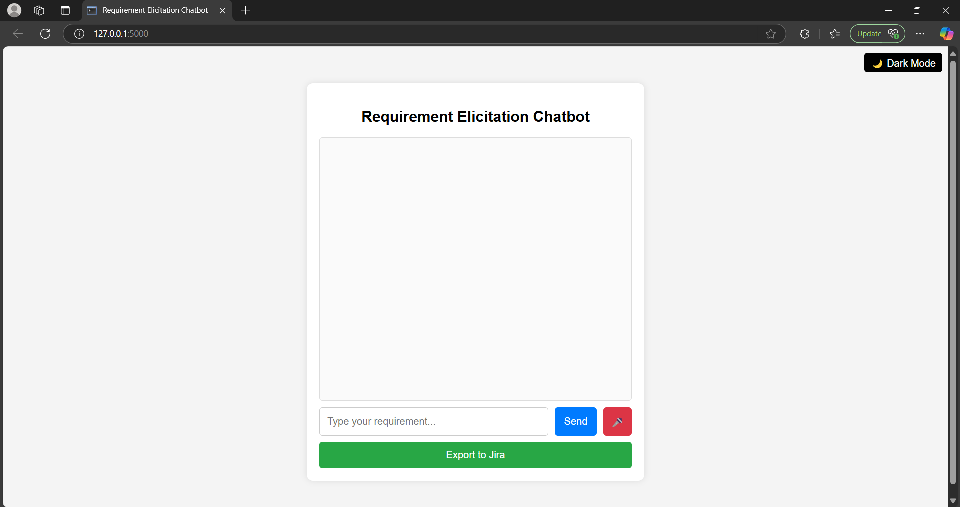
Prototype
INTERFACE

Slide 12
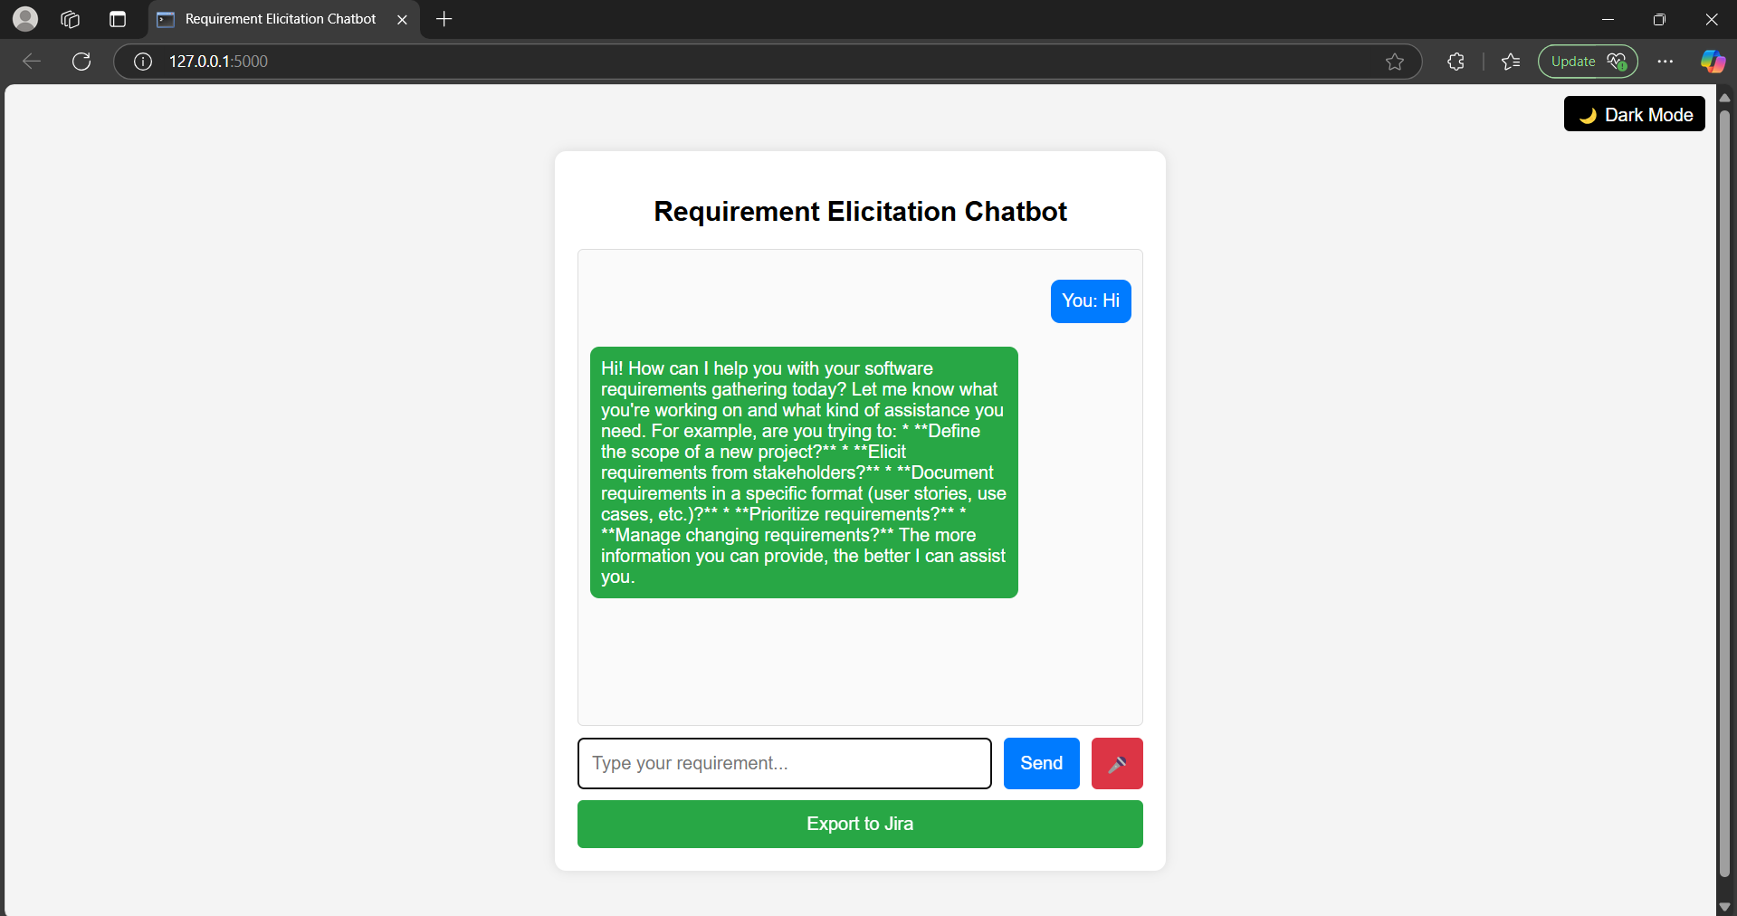
CHATBOT’S RESPONSE

Slide 13
Challenges & Limitations
Issues Faced During Development:
Difficulty in accurately understanding and processing ambiguous stakeholder inputs.
Ensuring the chatbot maintains context throughout long conversations.
Integrating the chatbot with external tools like Jira and Confluence.
Handling variations in requirement phrasing across different industries.
Possible Constraints:
Dependency on high-quality training data for accurate requirement elicitation.
Scalability issues when handling multiple concurrent users.
Security concerns in processing and storing sensitive project data.
Limitations in AI’s ability to fully replace human judgment in complex requirements gathering.

Slide 14
Future Scope
Enhancements or Improvements:
Implement advanced NLP techniques like transformer-based models for better requirement understanding.
Improve chatbot context retention for handling multi-turn conversations.
Enhance integration with project management tools for seamless requirement tracking.
Develop a user-friendly dashboard for real-time monitoring and analysis of gathered requirements.
How This Project Can Be Extended Further:
Expand support for multiple languages to cater to global teams.
Incorporate voice-based interactions for a more intuitive user experience.
Leverage AI-driven analytics to provide insights and recommendations on gathered requirements.
Deploy the system on cloud platforms for better scalability and accessibility.

Slide 15
Conclusion
Summary of the Project:
The AI-driven requirement elicitation chatbot automates the process of gathering software requirements, reducing human effort and improving accuracy.
It leverages NLP and AI techniques to extract, refine, and document requirements efficiently.
The system integrates with project management tools, ensuring seamless workflow integration.
By following industry standards, it enhances software development processes and minimizes requirement-related ambiguities.
Key Takeaways:
AI-powered chatbots can significantly streamline requirement elicitation.
NLP techniques improve understanding and processing of stakeholder inputs.
Integration with industry tools enhances usability and adoption.
Future advancements can further optimize the system for better accuracy and scalability.

Slide 16
References
Boehm, B. W. (1988). A spiral model of software development and enhancement. ACM SIGSOFT Software Engineering Notes, 11(4), 14-24. https://doi.org/10.1145/12944.12948
Sommerville, I. (2015). Software Engineering (10th ed.). Pearson Education.
Google AI. (2022). Transformer models for conversational AI. Google AI Research Papers. Retrieved from https://ai.google/research/pubs/
Pohl, K., Rupp, C., & Berenbach, B. (2011). Requirements Engineering: Fundamentals, Principles, and Techniques. Springer.
Chandrasekaran, M., Miao, H., & Sundaresan, N. (2017). Leveraging AI for software requirement elicitation and analysis. Proceedings of the 2017 IEEE International Conference on Software Engineering, 573-584. https://doi.org/10.1109/ICSE.2017.58

Slide 17
Thank You!
Any Questions?
Feel free to ask if you have any questions or need further clarifications on:
Project functionality – How the AI-driven chatbot gathers and refines requirements.
Technical details – Tools, frameworks, and implementation methods used.
Challenges & Solutions – How we overcame development obstacles.
Future Enhancements – Potential improvements and scalability options.

